Slide 1
Channel analysis for passive communication with ambient light
22-03-2018
Rens Bloom
Notes:
Welcome
Passive Communication is communication in which we use energy that is already present.
We do that using ambient light, light that is already present.

Slide 2

About me and my study
TU Delft
Bachelor electrical engineering
Master ES (2014-2017)

Slide 3
Elective courses
IN4073 Embedded Real Time Systems
IN4026 Parallel Algorithms & Computers
IN4254 Smart Phone Sensing
Internship @TNO: hacking Android connections
ET4170 Computer Arithmetic
ET4171 Processor Design Project
ET4394 Wireless Networking
Notes:
Een lijstje met vakken die ik gevolgd en afgerond heb. Een paar andere keuzevakken heb ik wel deels gevolgd maar niet afgerond omdat ze teveel overlap hadden met andere vakken, of voor mij niet interessant genoeg waren.

Slide 4
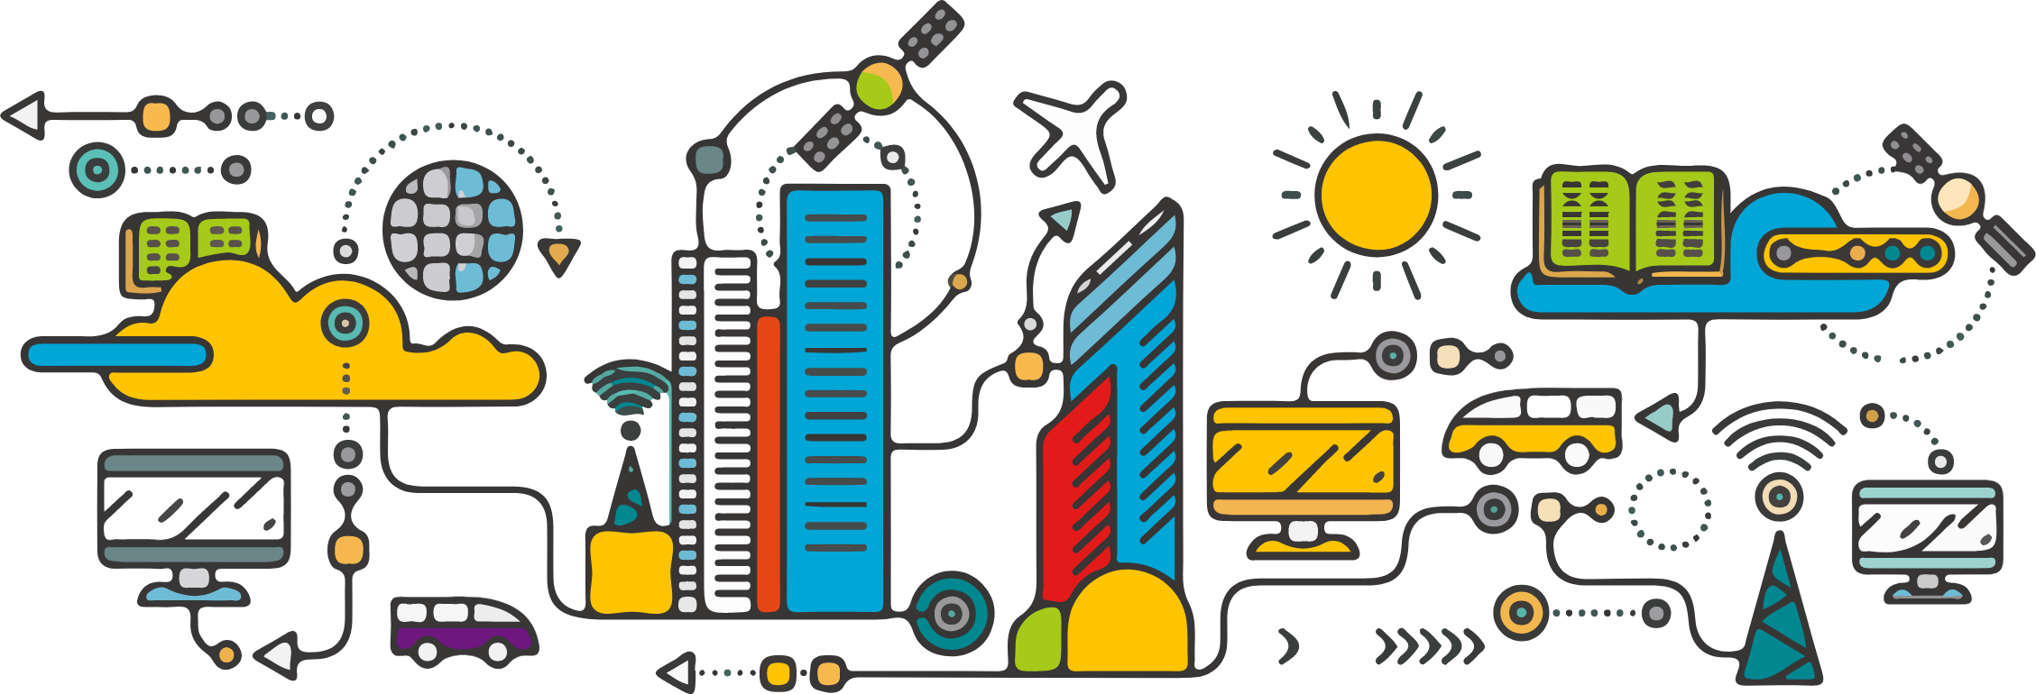
The future: smart cities
Challenge: communication
Notes:
Let’s take a look into the future.
Challenge: communication
Communication is expensive
We see smart cities in which connectivity of devices grows.
Grote steden willen sensoren in deze stad plaatsen om leefkwaliteit te meten. Denk dan aan sensoren die luchtkwaliteit en verkeersintensiteiten in de gaten te houden, maar ook sensoren die communiceren met voorbijrijdende bussen en vrachtwagens.
De sensorapparaten moeten ook weer kunnen communiceren, terwijl we eigenlijk willen dat daarvoor eigenlijk geen energie wordt verbruikt.

Slide 5
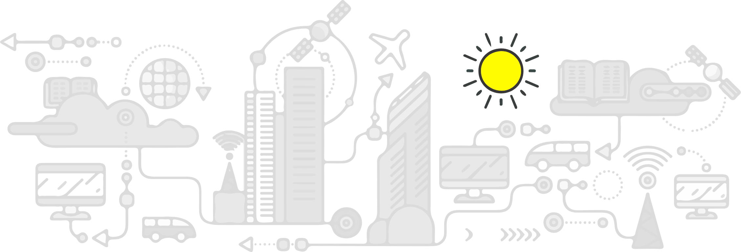
The future: smart cities
Challenge: communication
Notes:
The sun is an abundant resources that provides energy.
We want to use the energy of the sun for communication.
Natural soure of energy
Not only using solar panels
We do not need radio communication, that consumes a lot of power to generate a carrier
We thought and know now that that is possible.

Slide 6
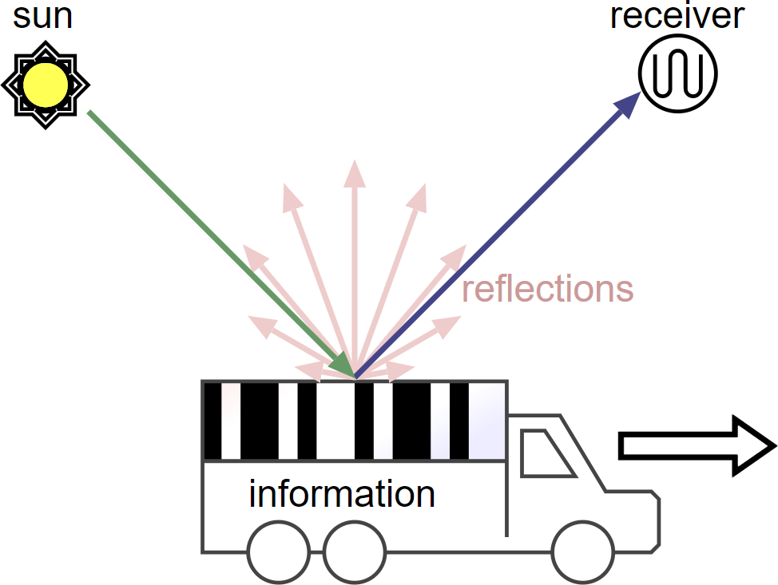
The passive light channel
Notes:
Kijken we weer naar het voorbeeld van communiceren van een sensor met voorbijrijdende vrachtwagens.
We think we do not need more than everything presented in this picture.
On the left we have the sun providing light.
In the center we have an object that changes reflections
On the right we have our receiver, a simple light sensor that generates an electrical signal.
Alle energie die nodig is voor de communicatie, hebben we in dit geval al: alleen de ontvanger niet.
Laten we dus vooral geen energieslurpende camera’s gebruiken, maar een simpele lichtsensor.

Slide 7
Goal of my project
How much information can we transmit using the passive light channel?
Notes:
- How much information can I convey?
We need to understand the channel completely to answer this question.

Slide 8
Important parameters
Sunlight
Clouds
Distance
Speed
Barcode size
Notes:
Zonlicht, maar ook met wolken moet het goed werken
Afstand zal van belang zijn alsmede snelheid van het object
- Depends on speed, size etc

Slide 9
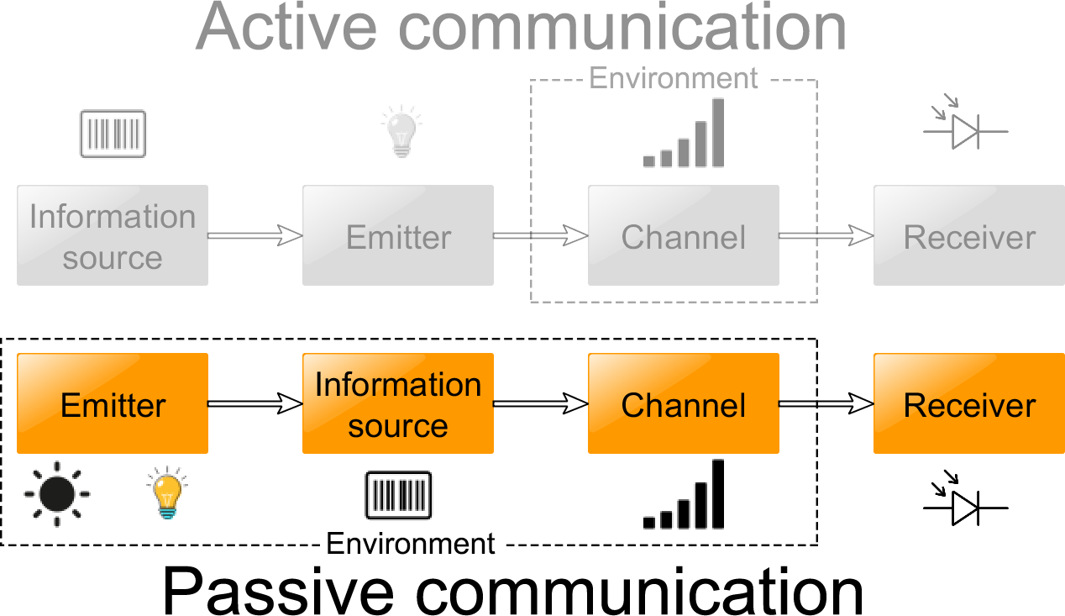
An uncontrollable channel
Notes:
Take my time
- In gray we see a normal radio communication channel. IS, Emitter, Channel distorts
- In orange we see the new communication channel. Emitter is uncontrolled, we can not control the object and the channel distorts.

Slide 10
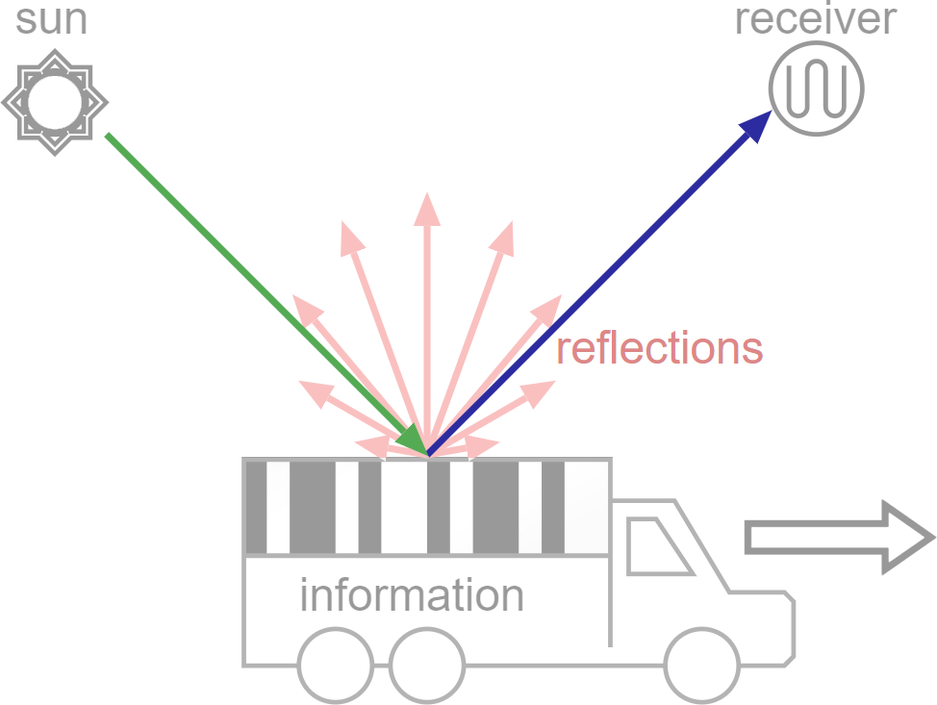
Reflections
Notes:
The passive light channel relies fundamentally on reflections.
The first question is to know what type of reflections we want to rely on.
We can not control the sun, thus lets look directly into the reflections of the sunlight.
Is important, because we need to ensure that light reaches the receiver.

Slide 11

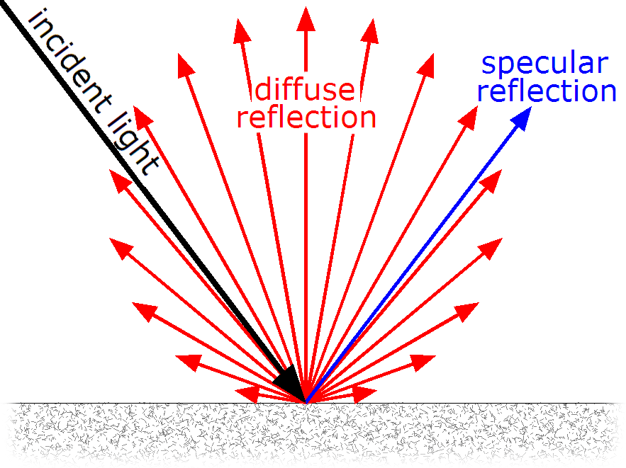
Reflection of light
Specular
or
Diffuse
Notes:
Light can reflect in two ways: diffuse or specular.
Specular reflection means that the light is reflected in one direction, like a mirror.
Diffuse reflection means that light is reflected in all directions, like it is reflected on paper.

Slide 12
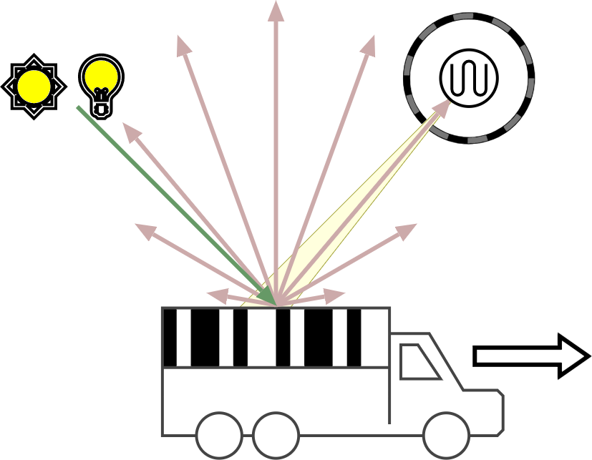
Diffuse light channel
It doesn’t matter where the light source is
We always receive light
Notes:
That’s why we want to use diffuse reflections.
It doesn’t matter where the light source is, because we can always receive the light.
Even when there are clouds in front of the sun. Any ambient light can be used.

Slide 13
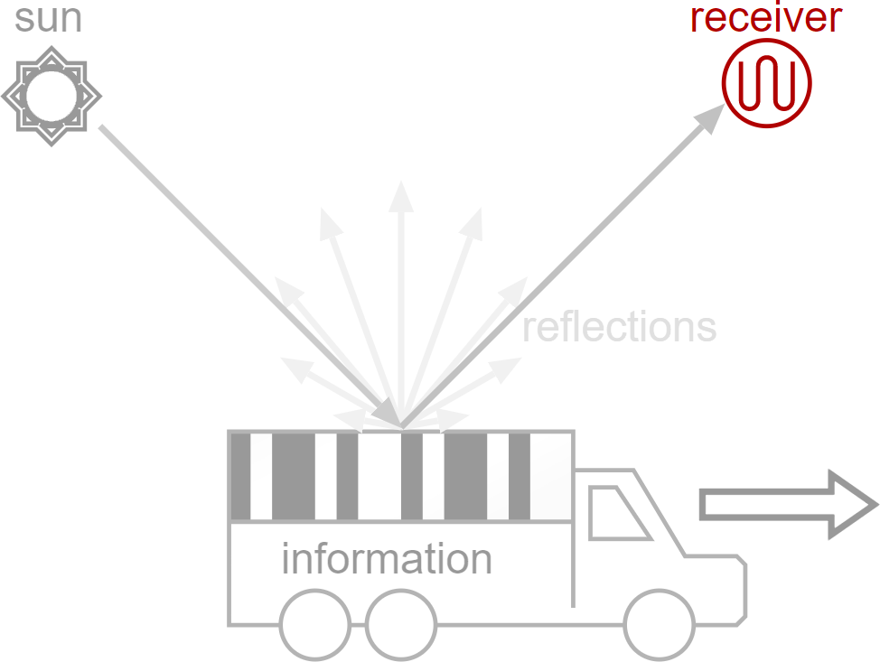
The receiver
Notes:
Let’s focus now on the receiver of the system.

Slide 14
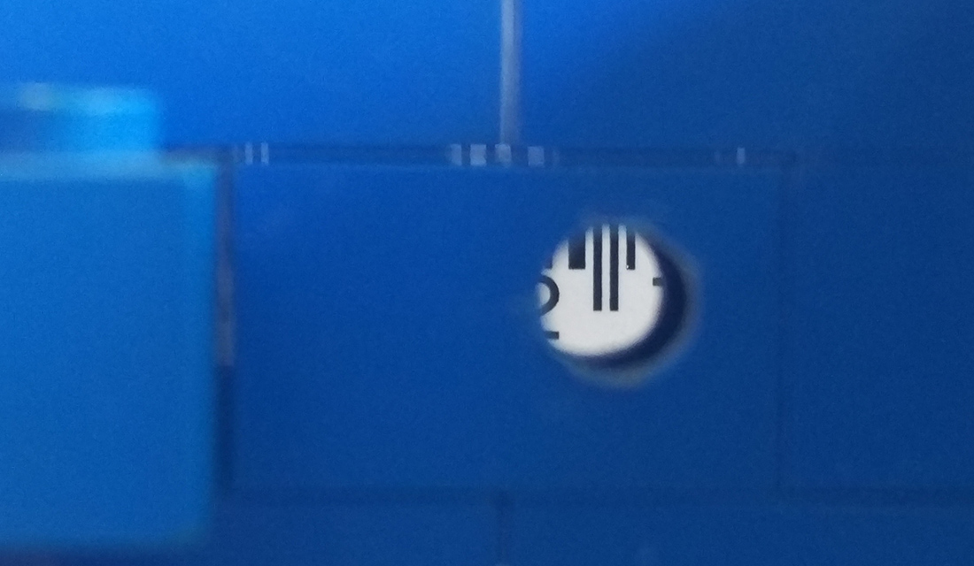
Receiver design: aperture
Limit the field-of-view with an aperture
Notes:
We want to capture only a small piece of the barcode.
We use a cap with a small aperture, such that we see only a small part.

Slide 15
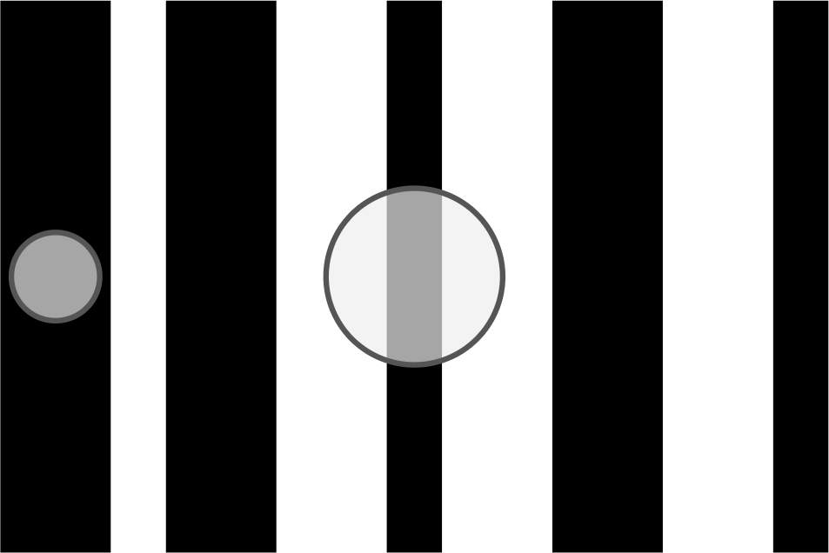
Receiver design: detection area
Small spot: good
Larger spot: intersymbol interference
Notes:
Small detection area (on the left), light from only one stripe is seen by the receiver. This is good.
On the right, multiple stripes are seen at the same time. This causes the signal to be mixed up.
We can have maximum 2 stripes in the detection spot to be able to read the barcode.

Slide 16
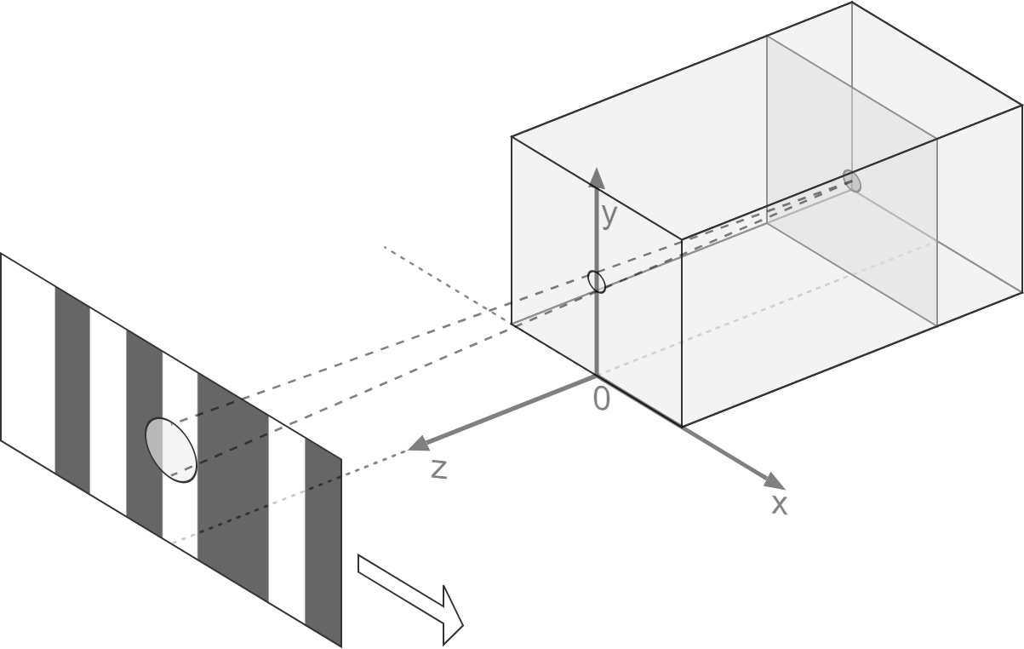
Receiver design: detection area
Smaller spot → More data
Smaller spot → Less light intensity
Notes:
We want to transmit as much data as possible, thus we want to reduce the size of the detection spot.
Making the spot smaller, goes at the costs of light intensity.
We want a small detection area with light intensity as high as possible.

Slide 17
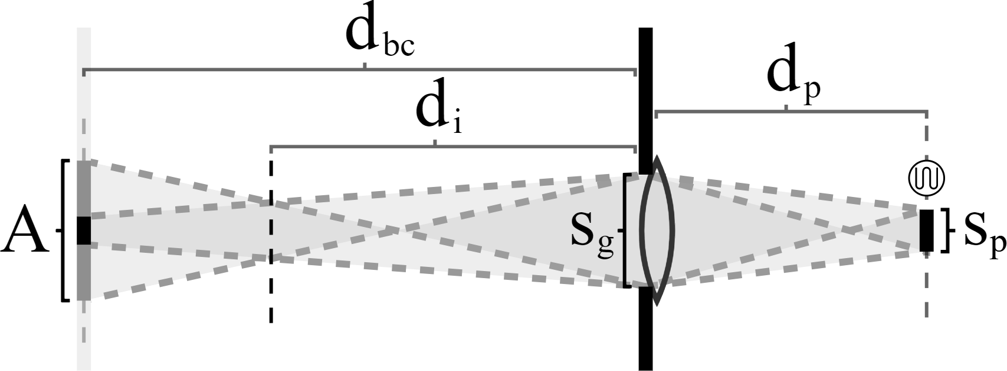
Receiver design: lens
Learn from optics: add a lens
Notes:
Als we licht aan het gebruiken zijn, moeten we ons niet alleen met de electronica beizghouden, maar ook leren van de optica. Met een lens kunnen lichtstralen geconcentreerd worden. Aan de hand van de parameters, en in dit geval simple geometrie, is af te leiden hoe sterk de lens ongeveer zou moeten zijn.
I added a lens to focus light beams from the detection area, expecting that it would work.
I made a ray-tracing simulation of this system, that can be found in my thesis.

Slide 18
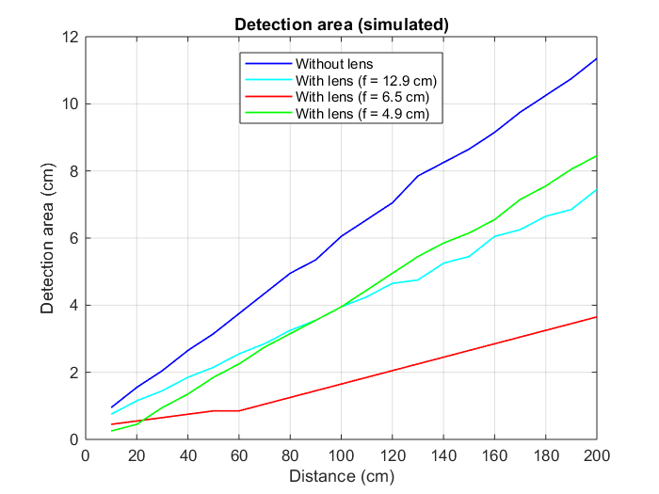
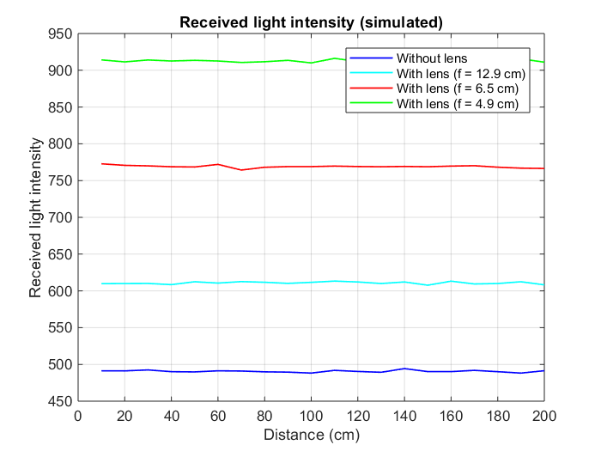
Receiver design: lens
With lens: higher light intensity
With lens: smaller detection area
Notes:
Interessanter zijn natuurlijk de gedetailleerde simulaties en de resultaten daarvan
Simulations showed that it indeed works
Added a lens (the red line): almost triple information density, increase received light

Slide 19
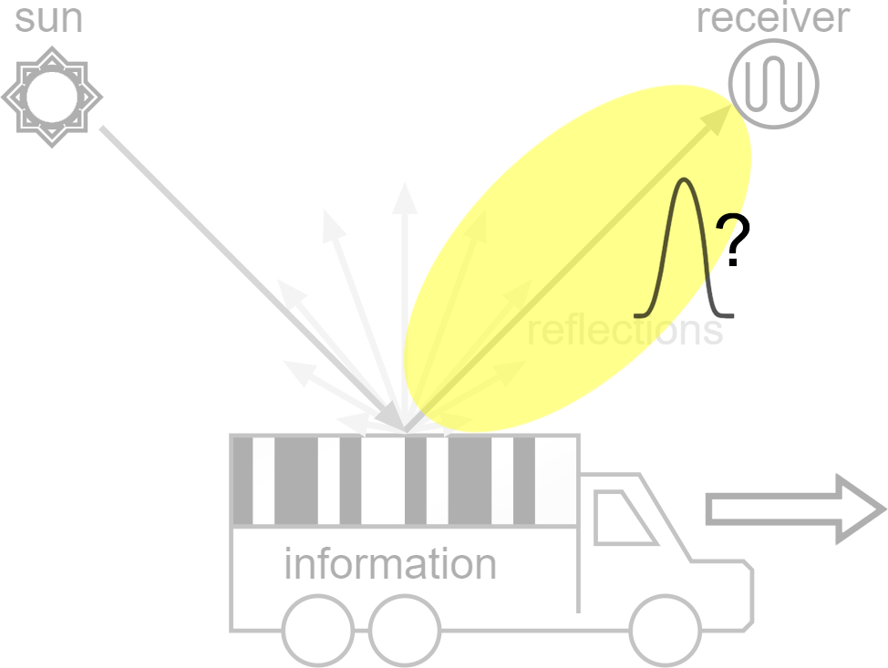
Model
Notes:
I already described the receiver, the reflections and the information object.
But the goal is to understand the behavior of the channel.

Slide 20
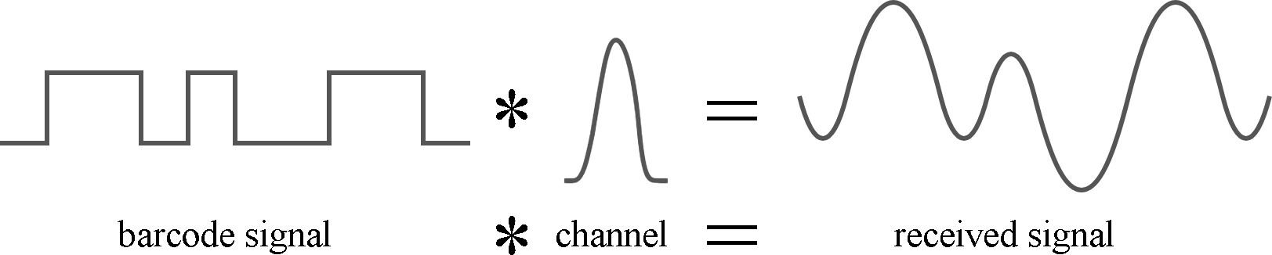
Convolutional channel model
Commonly used in telecommunications
Notes:
The signal that we transmit looks clean, but the signal we receive is distorted.
This is because of the channel response.

Slide 21
Convolutional channel model
Commonly used in telecommunications
Channel response h(x) instead of h(t)
Notes:
We have no control over the speed of the object. Lets describe the channel and signal on positions.
Use an optical model to retrieve the channel response.

Slide 22
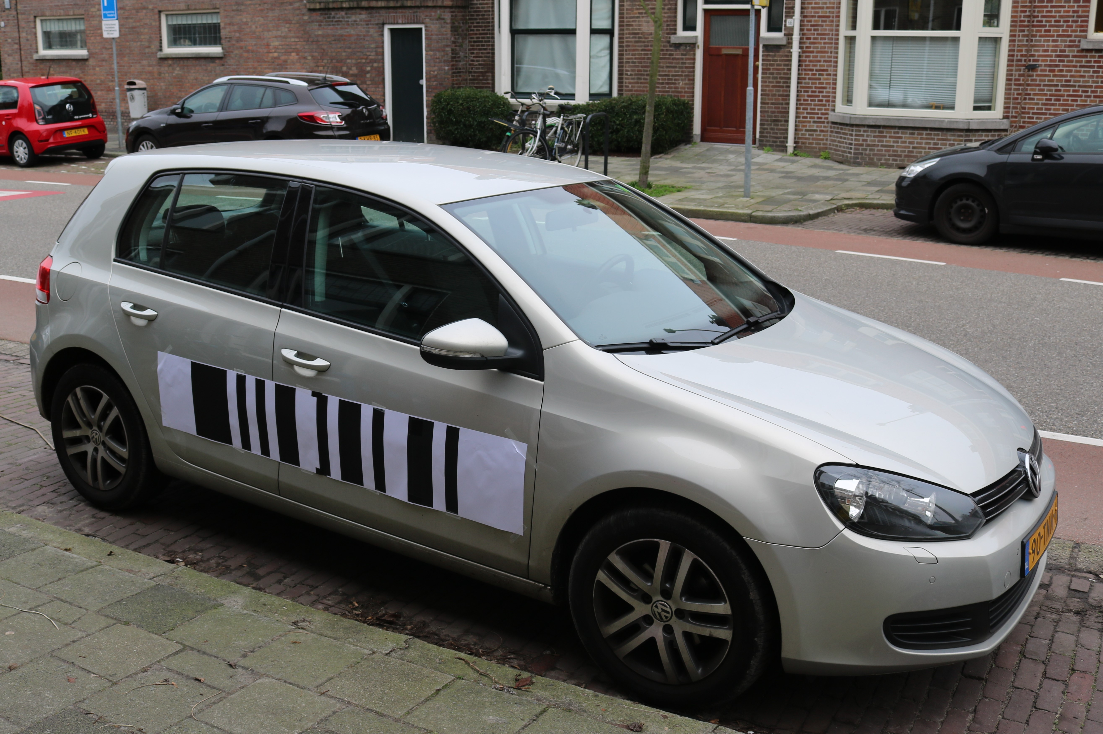
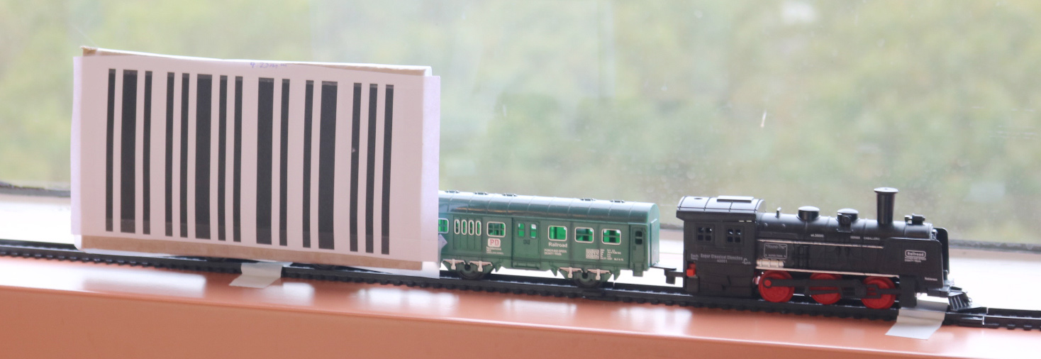
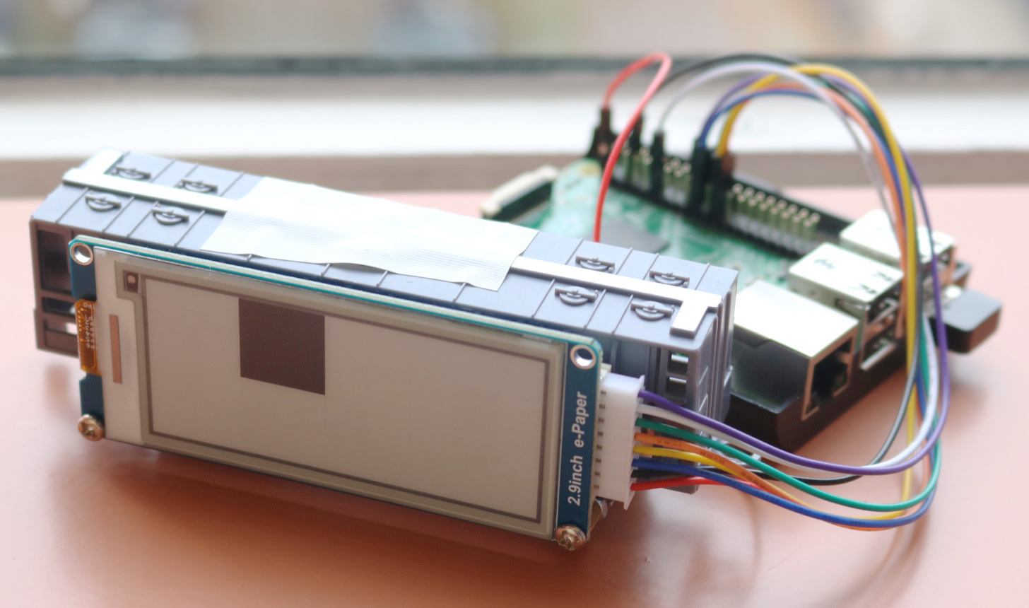
Evaluation: objects
Large- and small-scale experiments
Notes:
After modelling, I am able to estimate the signal that we will receive.

Slide 23
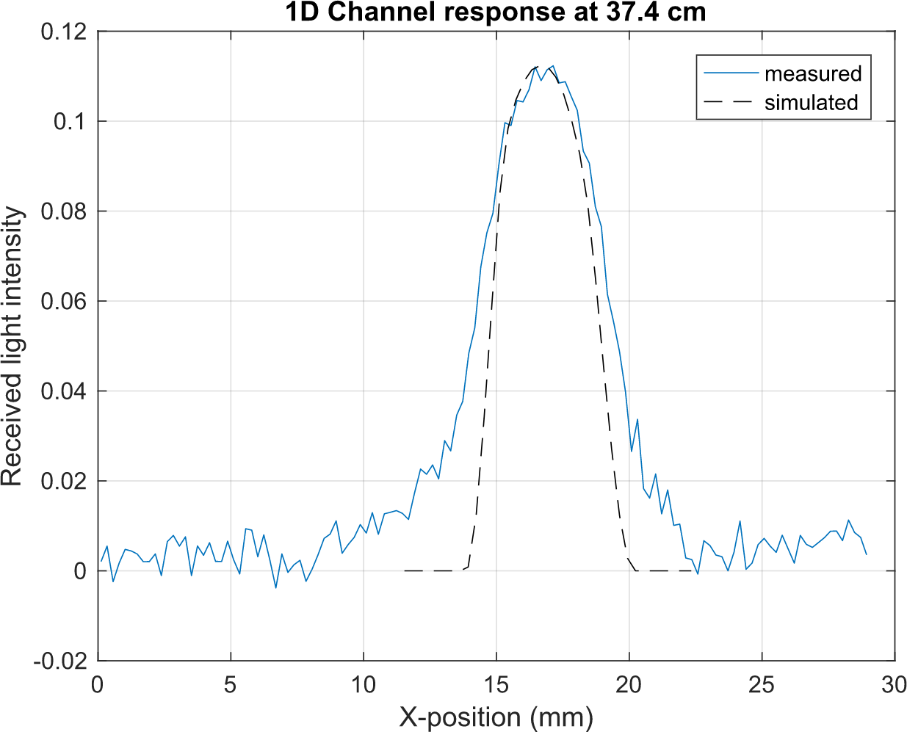
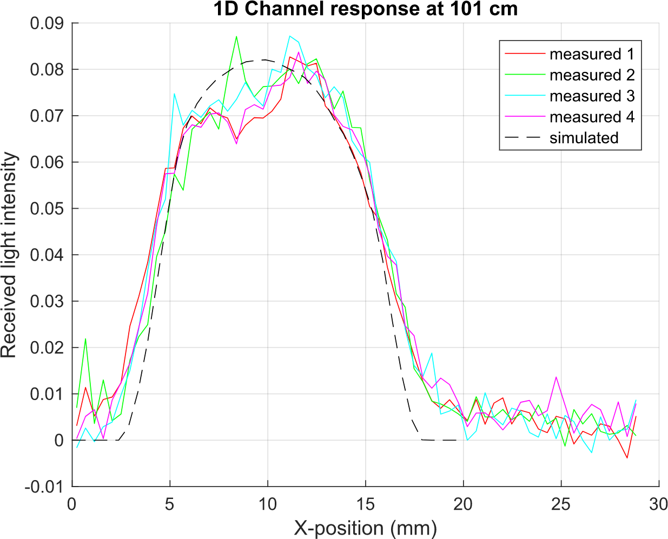
Channel response
Simulations vs measurements
Notes:
Indeed at 37cm distance the measured signal response has a wider peak than simulated.
This is probably due to reflections between the object and the receiver.
At 101 cm the simulations are a good match to the measured response.
Does the signal look like we would expect from this?

Slide 24
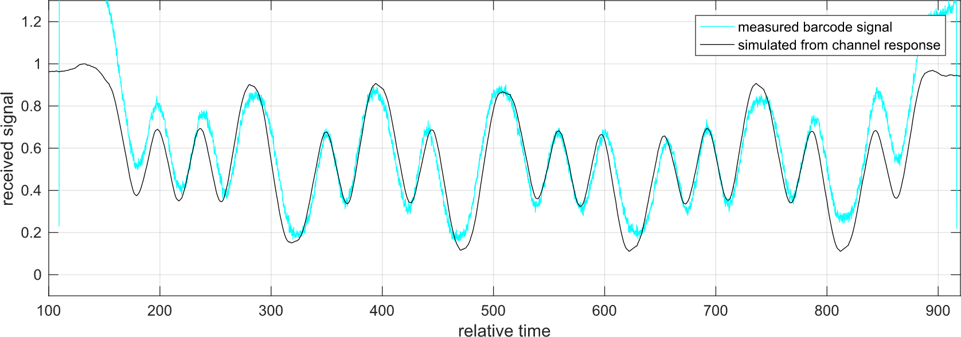
Evaluation: received signal
Channel response h(x) seems correct
Notes:
After modelling, I am able to estimate the signal that we will receive.
It is compared with the train.
From the channel response, we can simulate the received signal of an object and its accurate.

Slide 25
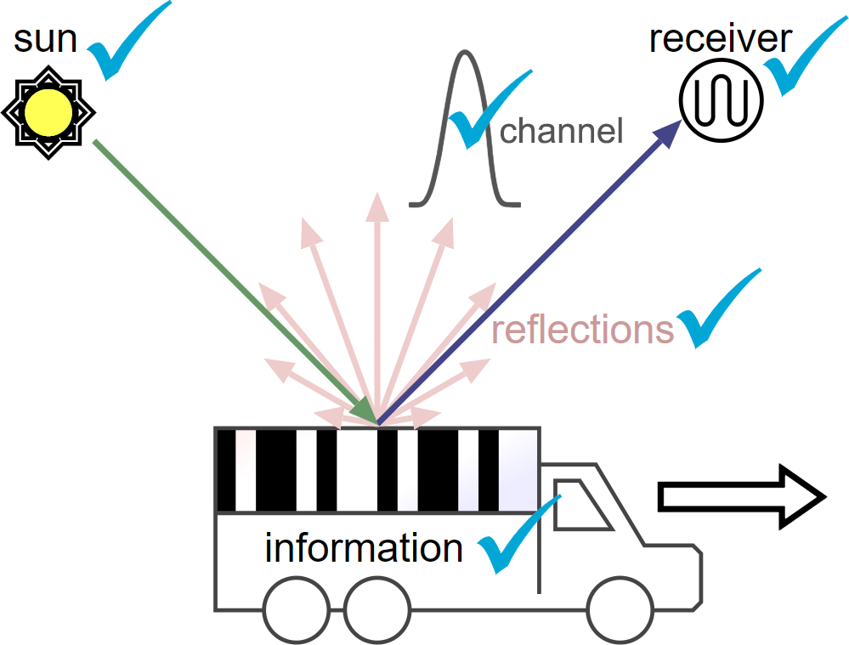
Behaviour is identified
Notes:
identified
reflections + light
receiver
information
channel
now we need an algorithm to decode the signal

Slide 26
Performance
Great performance with sunlight
Lighting | Barcode module | Signal frequency | Distance | # Test messages | Correctly decoded
Sunlight | 1 cm | 212 Hz | 37 cm | 201 | 100,0%
Sunlight | 1 cm | 215 Hz | 70 cm | 204 | 99,5%
Low | 1 cm | 25 Hz | 37 cm | 24 | 100,0%
Low | 1 cm | 60 Hz | 70 cm | 56 | 98,2%
Low | 1 cm | Varying | 37 cm | 116 | 84,5%
Low | 1 cm | Varying | 70 cm | 115 | 86,1%
Low | 1 cm | 195 Hz | 37 cm | 184 | 57,6%
Low | 1 cm | 220 Hz | 70 cm | 209 | 49,3%
Notes:
See the effect with sunlight.
Everything works great. In tests with a barcode module of 1 cm

Slide 27
Performance
Low light condition → decrease speed
Lighting | Barcode module | Signal frequency | Distance | # Test messages | Correctly decoded
Sunlight | 1 cm | 212 Hz | 37 cm | 201 | 100,0%
Sunlight | 1 cm | 215 Hz | 70 cm | 204 | 99,5%
Low | 1 cm | 25 Hz | 37 cm | 24 | 100,0%
Low | 1 cm | 60 Hz | 70 cm | 56 | 98,2%
Low | 1 cm | Varying | 37 cm | 116 | 84,5%
Low | 1 cm | Varying | 70 cm | 115 | 86,1%
Low | 1 cm | 195 Hz | 37 cm | 184 | 57,6%
Low | 1 cm | 220 Hz | 70 cm | 209 | 49,3%

Slide 28
Conclusion
Testbed
Simulation tools
Evaluated the model
It works
Notes:
To conclude:
I made a testbed
Simulation tools
Evaluated the model

Slide 29
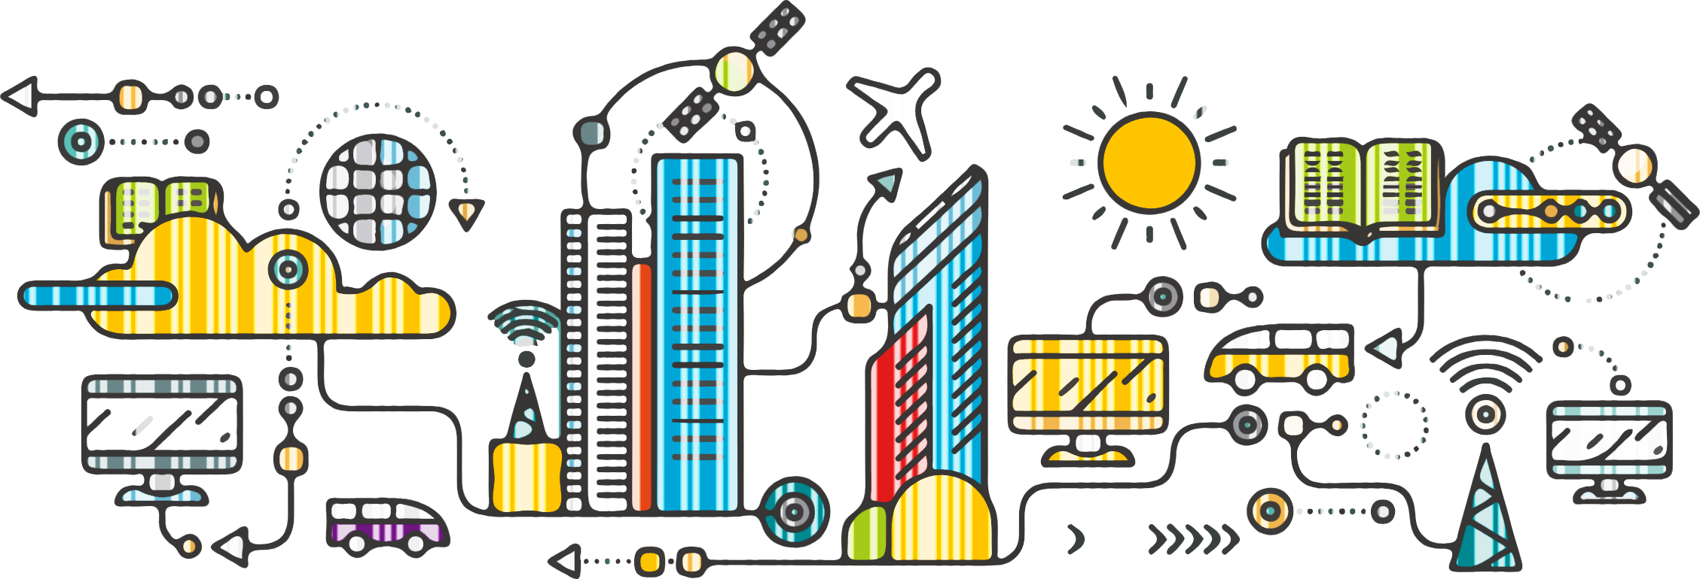
The future
Notes:
Make it ready for a large connected city, such that the sunlight is not wasted.

Slide 30
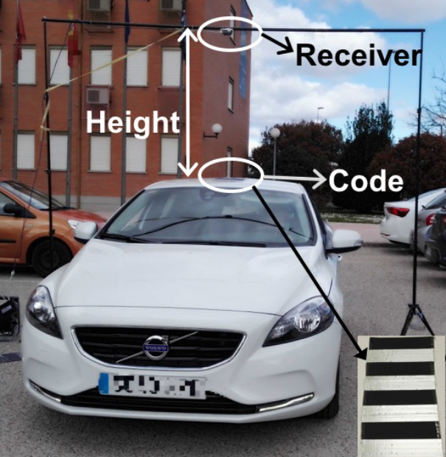
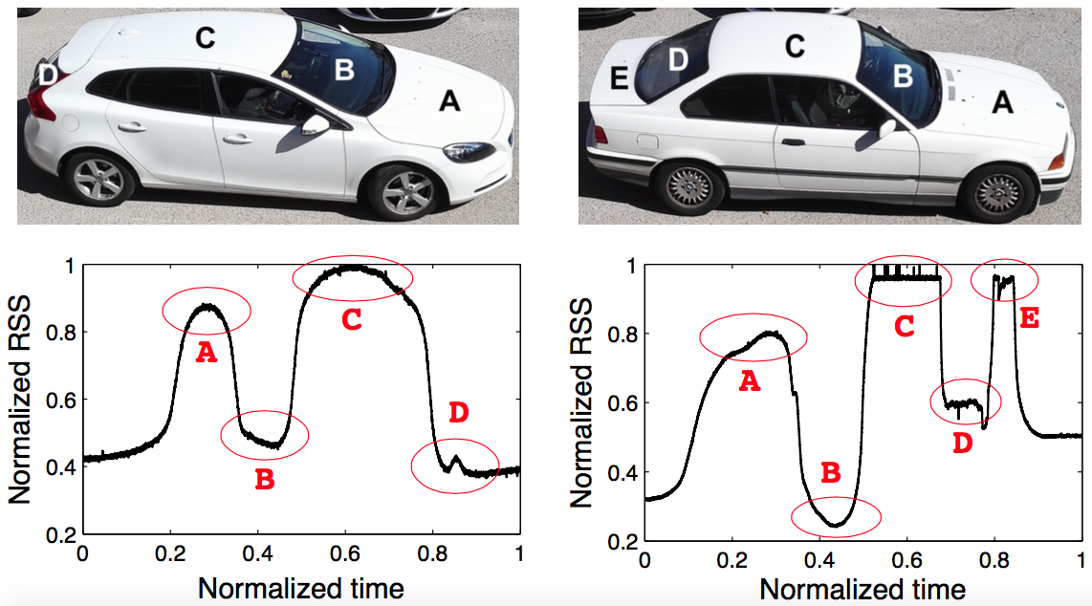
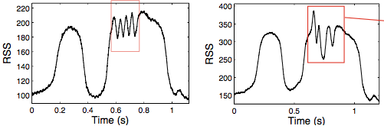
State of the art
Proof of concept was already made
Notes:
A proof of concept was made before. Slow, Large, Short distance, Small message
Explain the setup:
Parking lot, sensor on top

Slide 31
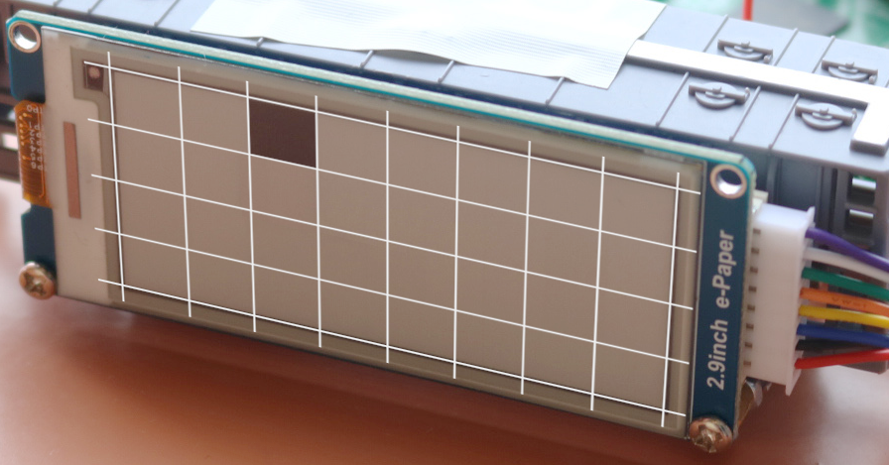
Optical model
Subdivide object in a grid
Simulate light rays from each square
Check the contribution of each square
Notes:
Simulation = ray tracing, simulate a diffuse distribution and lens refraction
We want to see the contribution of each tiny square

Slide 32
Decoding challenges
Object/signal speed is unknown
Object/signal speed can fluctuate
Illumination can change
Notes:
Unknown (altering) frequency and unknown (altering) amplitude

Slide 33
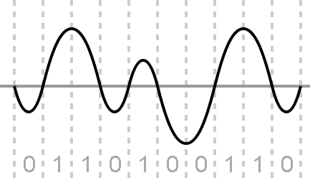
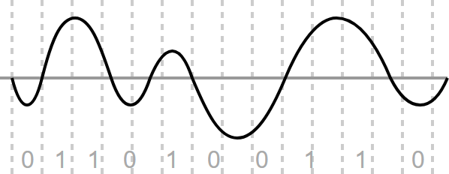
Decoding challenge: speed
Normal signal decoders
Notes:
2 we have a traditional way to look to communication channels
Usually, as in the left picture it works great as long as the signal frequency stays constant.
In the right picture, we see what could happen in our system.
The speed of the object is not constant and we can not divide the sampled signal in equal periods.

Slide 34
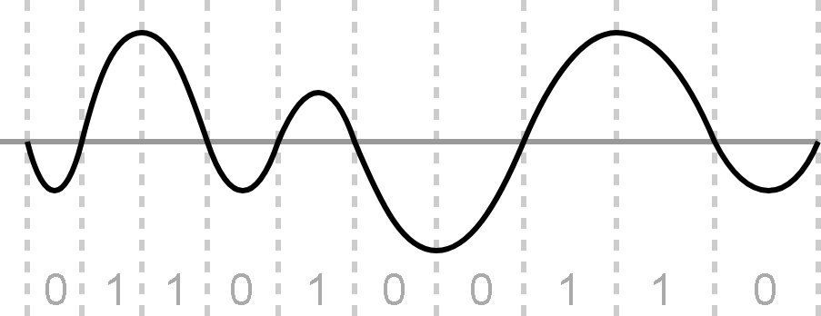
Decoding challenge: speed
Normal signal decoders
Look at barcode scanners
Notes:
I searched for an decoding algorithm that can work in this case and found out that barcode scanners handle similar problems.

Slide 35
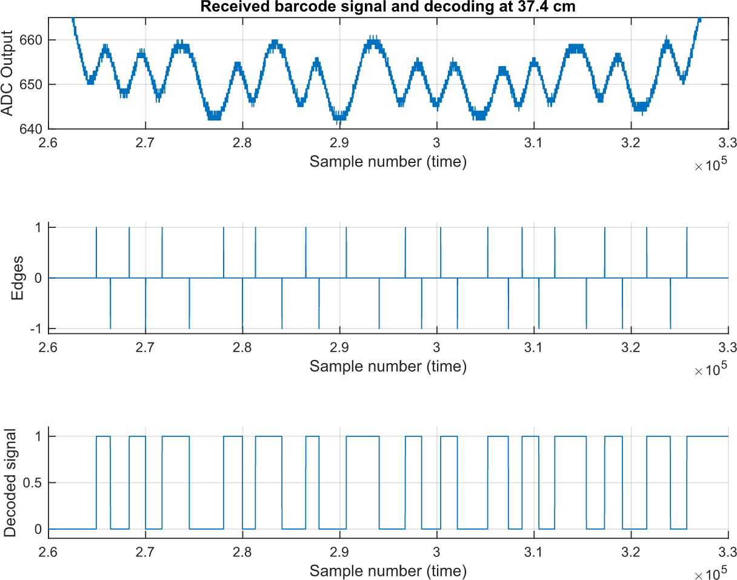
Decoding algorithm
Find the edges in the signal
Notes:
I built by decoding algorithm on top of what is being used in barcode scanners.
The decoding algorithm detects the edges in the signal. Those are the transitions between black and white.
From the detected edges, the original barcode signal can be restored.
Using this decoding algorithm we could show the performance of the system.
From the bottom signal we can compensate for time fluctuations

Slide 36
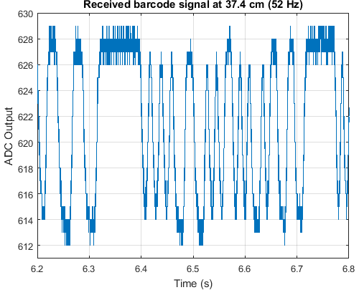
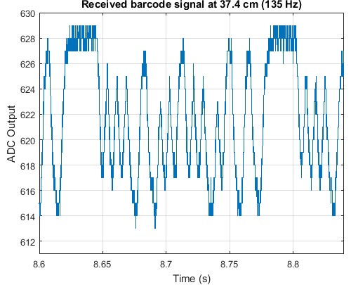
Signal distortion
Distortion under low light conditions
Notes:
However, in a low-illuminated environment, the signal already gets distorted at 135 Hz.
On the left: 50 Hz, on the right the distorted signal (135 Hz) in which the peaks and valleys do not have the same amplitude.
So there is some time dependency based on the light intensity.

Slide 37
Performance
We can handle speed fluctuations
Lighting | Barcode module | Signal frequency | Distance | # Test messages | Correctly decoded
Sunlight | 1 cm | 212 Hz | 37 cm | 201 | 100,0%
Sunlight | 1 cm | 215 Hz | 70 cm | 204 | 99,5%
Low | 1 cm | 25 Hz | 37 cm | 24 | 100,0%
Low | 1 cm | 60 Hz | 70 cm | 56 | 98,2%
Low | 1 cm | Varying | 37 cm | 116 | 84,5%
Low | 1 cm | Varying | 70 cm | 115 | 86,1%
Low | 1 cm | 195 Hz | 37 cm | 184 | 57,6%
Low | 1 cm | 220 Hz | 70 cm | 209 | 49,3%
Notes:
Original work had zero reception with varying speed

Slide 38
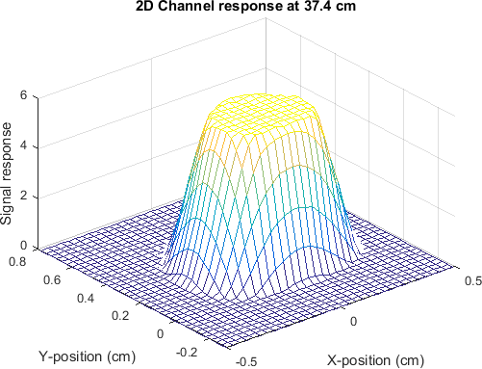
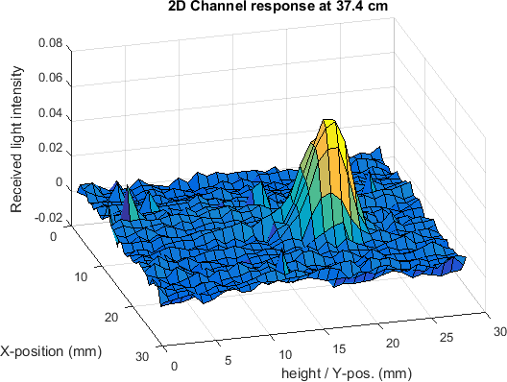
Optical response
Contribution of each subarea
Notes:
The integral of the optical response gives the channel response.
We can simulate (left) or measure (right) the optical response.

Slide 39
Overview
What type of reflections to use?
System & Model
Evaluation
Notes:
Let’s give a short overview of the topics I’m going to discuss in this presentation

Slide 40
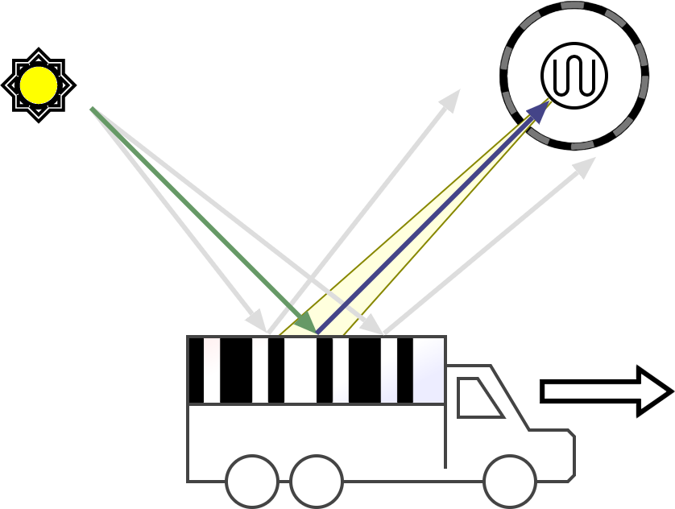
Specular light channel
At one spot, light reflects to our receiver
Notes:
At one spot light reflects toward the receiver.
If we ensure that the sensor sees this spot, we could read the object.

Slide 41
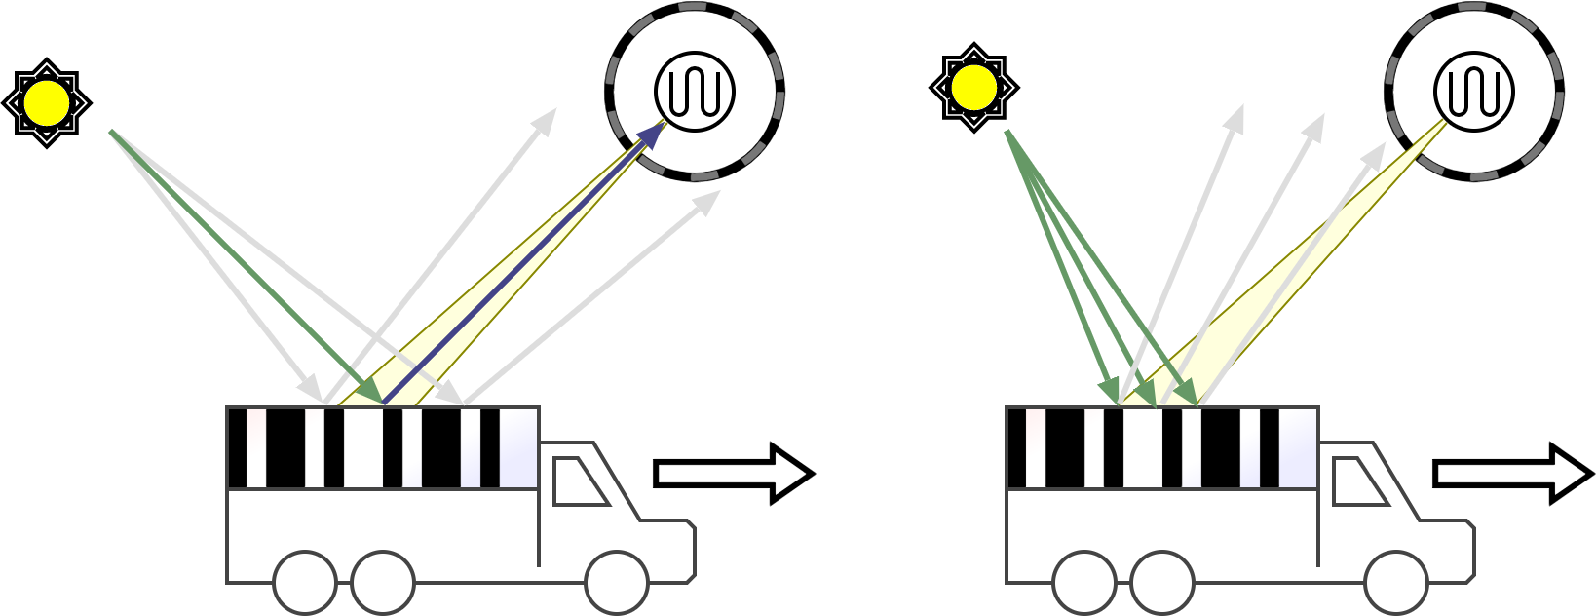
Specular light channel
When the sun moves, reflections change
We might miss the specular reflection
Notes:
But, when the light sources moves, the direction of the light changes.
We know that the sun moves during the day, thus it can occur that we he specular reflections do not reach the sensor.

Slide 42
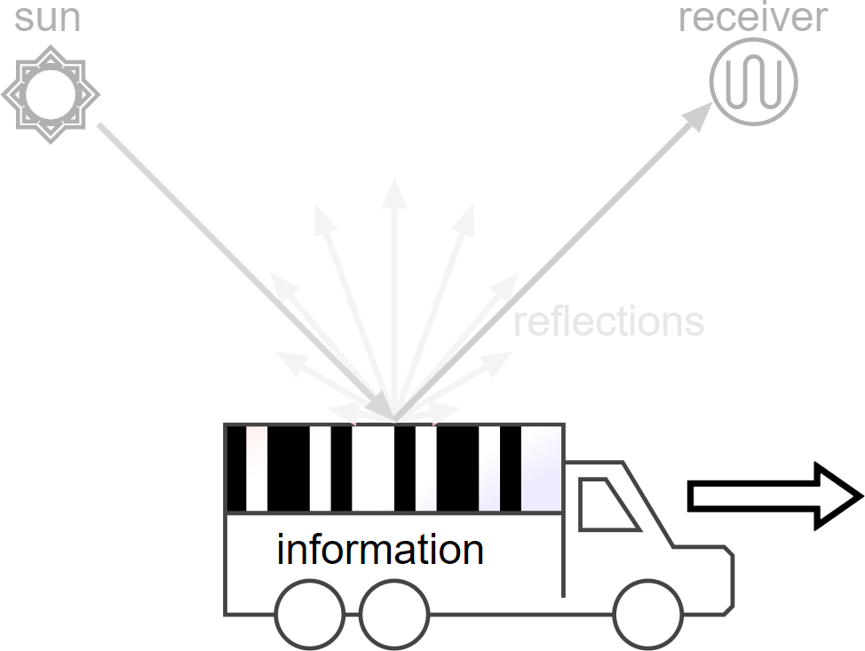
The information source
Notes:
Let’s focus now on the object that carries the information.
In a previous concept it was a car with a barcode, as shown in this picture. need to scale down

Slide 43

Information source
Diffuse reflection
Variable speed
Granularity
Notes:
We know from the previous analysis that we need diffuse reflections.
Car are not practical for doing measurements, thus the information source should be smaller and easier to test with.
Toy train

Slide 44
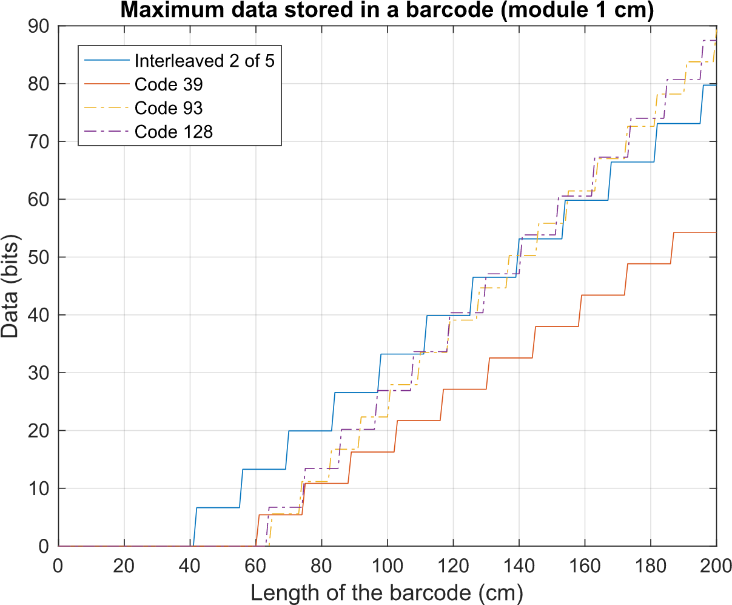
Channel capacity

Slide 45
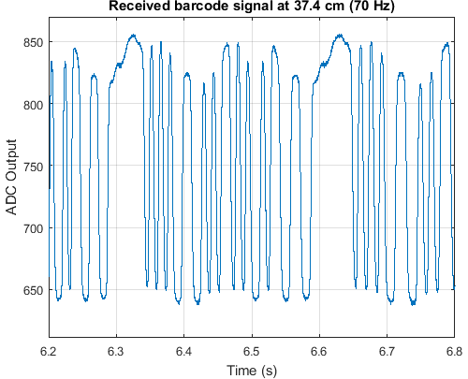
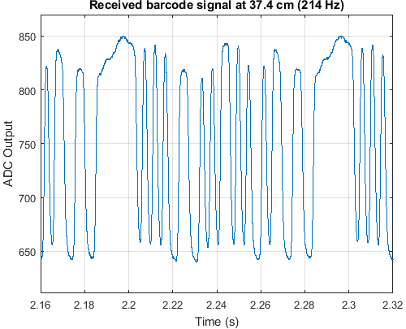
Received signal
Higher speeds with sunlight
Notes:
In a well-illuminated environment the received signal looks clean.
If we increase the object speed to have a signal frequency of 214 Hz, it still works perfectly.

Slide 46
System constraints
Barcode module:
minimum width of a barcode stripe
Notes:
Let’s go to the system constraints: we are looking for a minimum value of the module of the barcode.
explain module = thinnest stripe in a barcode
From the simulations and measurements we can determine the minimum module of a barcode.
The module is the minimum width of a stripe in the barcode.

Slide 47
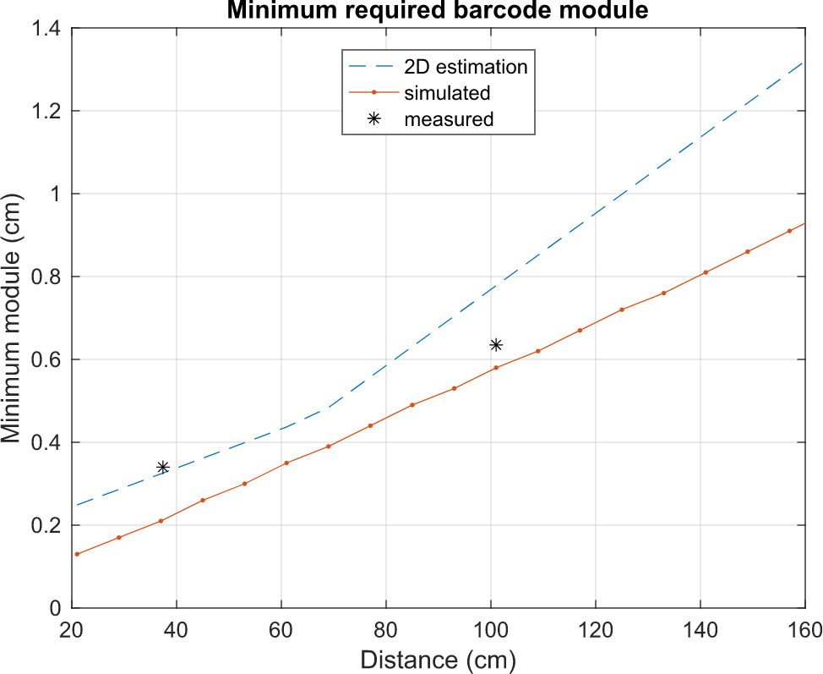
System constraints
2D generalization → good estimate
Notes:
The further away from the receiver, the larger the barcode should be.
Instead of all compelx simulations, we could do a generalization too.
If we compute the minimum module from a 2D version of the system, we are a bit overestimating the minimum module

Slide 48
Performance
Great performance with sunlight
Lighting | Barcode module | Signal frequency | Distance | # Test messages | Correctly decoded
Sunlight | 1 cm | 212 Hz | 37 cm | 201 | 100,0%
Sunlight | 1 cm | 215 Hz | 70 cm | 204 | 99,5%
Low | 1 cm | 25 Hz | 37 cm | 24 | 100,0%
Low | 1 cm | 60 Hz | 70 cm | 56 | 98,2%
Low | 1 cm | Varying | 37 cm | 116 | 84,5%
Low | 1 cm | Varying | 70 cm | 115 | 86,1%
Low | 1 cm | 195 Hz | 37 cm | 184 | 57,6%
Low | 1 cm | 220 Hz | 70 cm | 209 | 49,3%

Slide 49
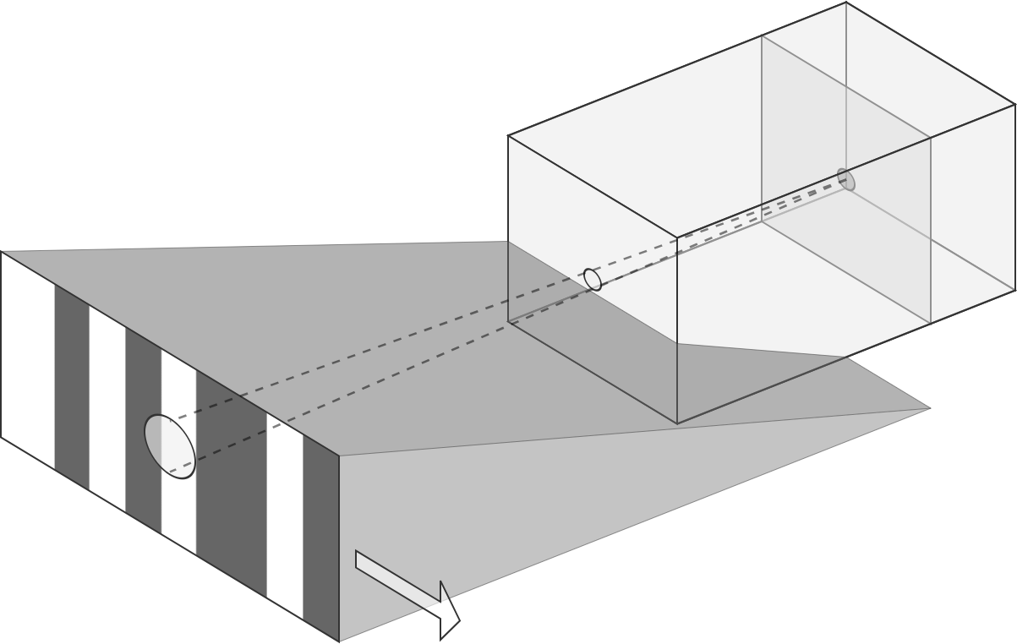
Shadow

Slide 50
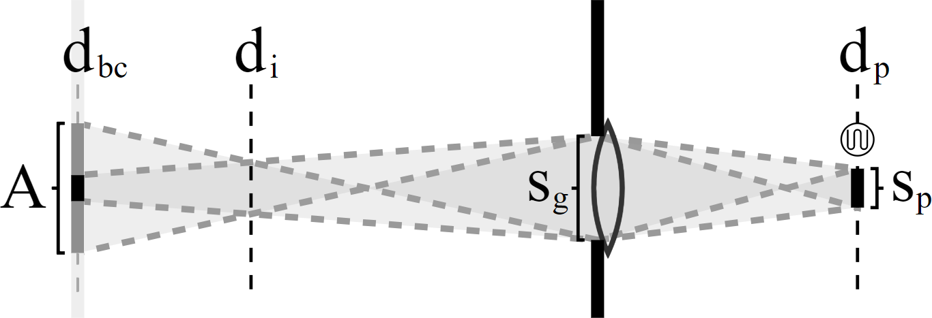
2D system

Slide 51
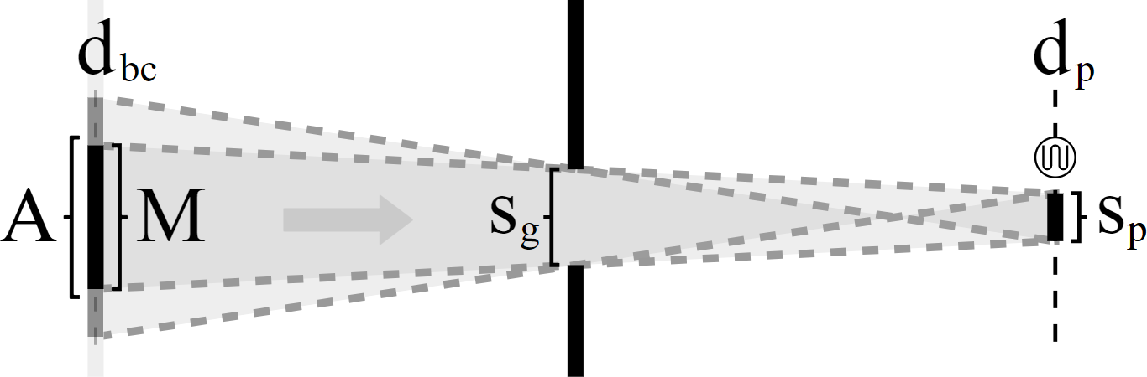
2D system without lens

Slide 52
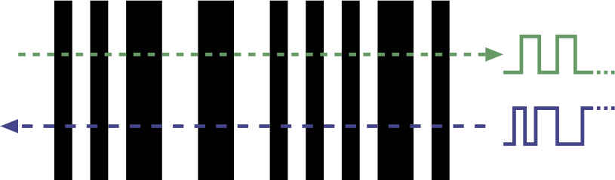
Signal direction

Slide 53
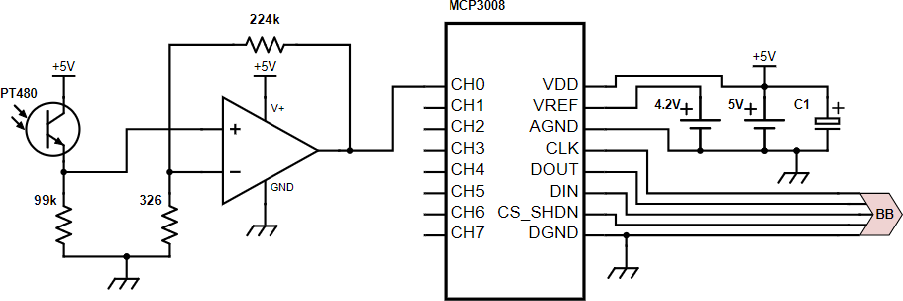
Electrical circuit

Slide 54
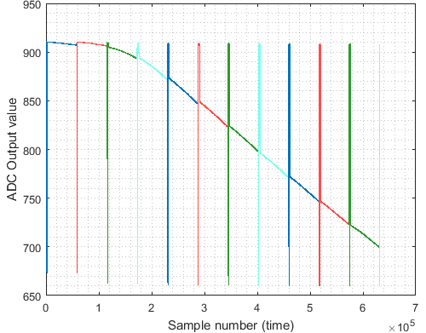
Linearity

Slide 55
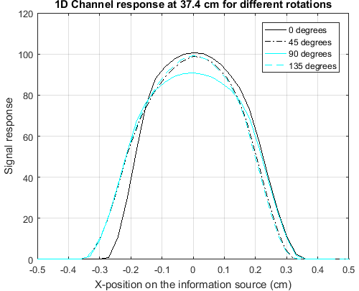

Misalignment
No symmetrical behaviour

Slide 56

Photodiode

Slide 57

Phototransistor

Slide 58
Goals of my project
Investigate the behaviour of the passive light channel
How much data can we transmit using this channel?
Approach
Develop a model to understand its characteristics
Design a testbed to validate the theory
Notes:
- How much information can I convey?
Then my goals: try to understand everything. We know that it works, but we want to know how it works and what we could achieve in the end.
Next to this, of course improving the system has some importance too. I want to describe the limitations of this system, thus I should find them.

Slide 59

History: KarTrak
1960s
A visible pattern as ‘tag’
Identification of train cars
The first barcodes
Then: 600W light bulbs
Notes:
Now, let’s learn from history. KarTrak was developed in 1960s as an identification system of train cars in the US.
Have been replaced by Radio-tags.
Technology has improved a lot.
Can we send something like a tag in a completely passive manner using light?

Slide 60
Topology
Notes:
Detection area
Sensor in the gray box
Gray box = receiver

Slide 61


Optical response (101 cm)
Sensitivity per subarea
Notes:
If we increase the distance, the size of the peak is equal in the measurements and simulations. The shape of the peak is

